Slide 1
Breast Cancer Detection Prediction
Data Science Capstone Project
Hauwanat A Balogun
August 2023

Slide 2
Problem Statement
How can one predict early stages of breast cancer given the breast cancer features?

Slide 3
Goal
Build models to predict breast cancer detection
To provide useful information and ways for breast cancer detection

Slide 4
Dataset
Kaggle Breast Cancer dataset:
https://www.kaggle.com/datasets/merishnasuwal/breast-cancer-prediction-dataset
Features examples:
Mean radius
Mean area
Mean perimeter

Slide 5
Data Wrangling
Major Steps:
Check for missing values: 0 missing values
Transform numerical features to categorical when they are true categorical
Encode certain categorical features as ordered numbers

Slide 6
Exploratory Data Analysis

Slide 7
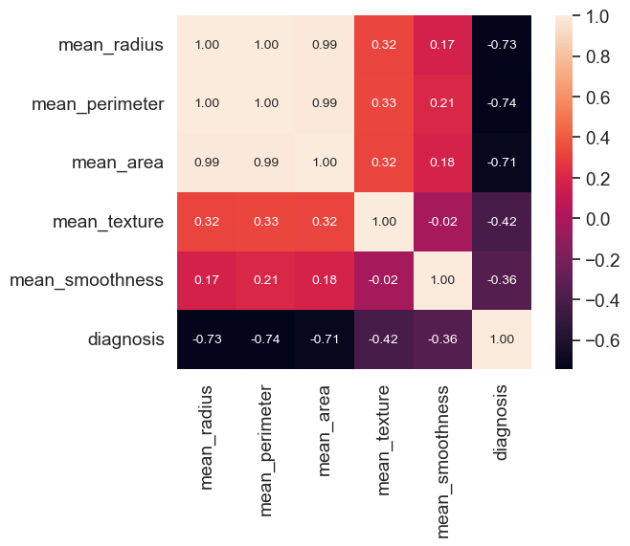
Numeric Attributes Correlating with Mean Radius
Top Significant Categorical Attributes Discovered via heat map (with values)

Slide 8
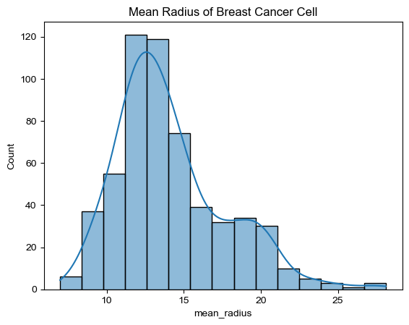
Mean Radius of Cancer Cells
The average mean radius with the most count is between 10 and 15, this indicates that this could be the average mean radius for detection of breast cancer cells.

Slide 9
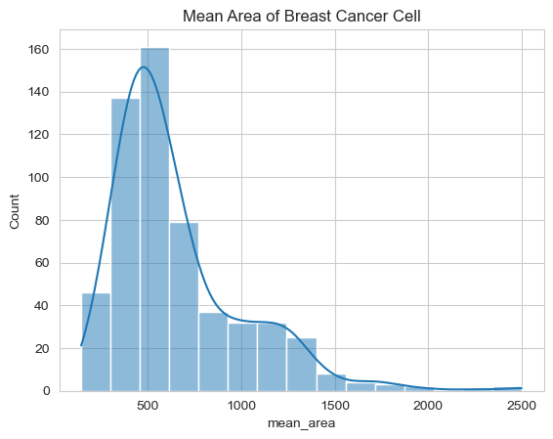
Mean Area of Cancer Cells
The mean area’s count and mean radius’ count are approximately the same count, therefore indicating they are directly correlated.

Slide 10
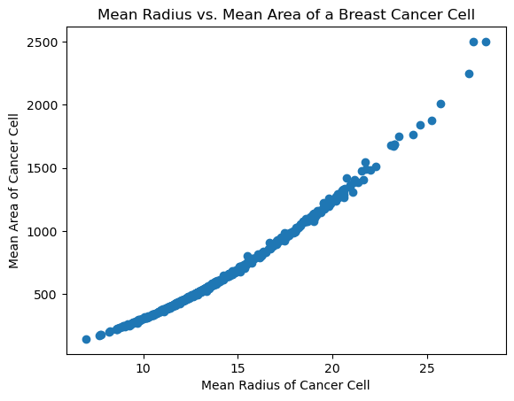
Mean radius vs Mean Area of
There is a relation between mean radius and mean area of cancer cells. The higher the mean radius, the higher the mean area of the cancer cells. This is slowly and indication of our hypothesis.

Slide 11
Feature Engineering & Modeling

Slide 12
Feature Engineering
Feature Engineering Major Steps:
Encode some categorical features
Create new features
Log transform of the skewed numerical features to lessen impact of outliers
Transformation of categorical features
Split into testing and training datasets
Standardize the magnitude of numeric features using a scaler
Model Optimization:
Random Forest
Logistic Regression

Slide 13
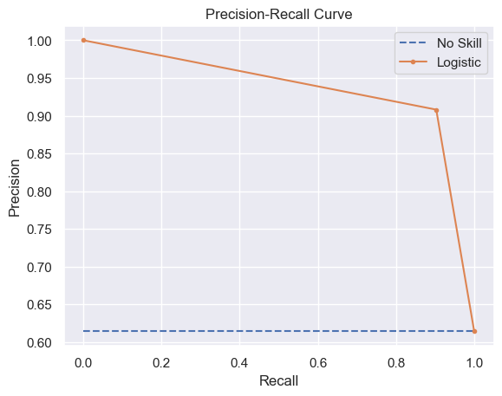
Modeling & Results
Modeling Major Steps:
Random Forest
Logistic Regression
Results:
Model with the most accurate step is Logistic Regression, with a precision score of 93%

Slide 14
Predictions & Future Improvements
Test other models for better predication and accuracy:
Linear Regression
Gradient Boosting
K Nearest Neighbor
Test other model parameters

